Slide 1
Portfolio Committee on Health
COVID-19 Public Health Response
10th April 2020

Slide 2
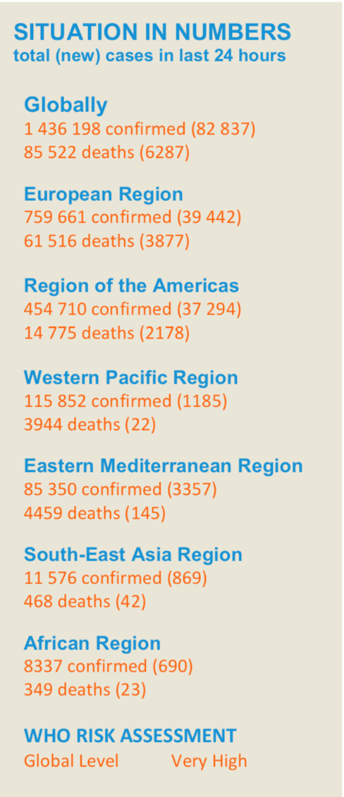
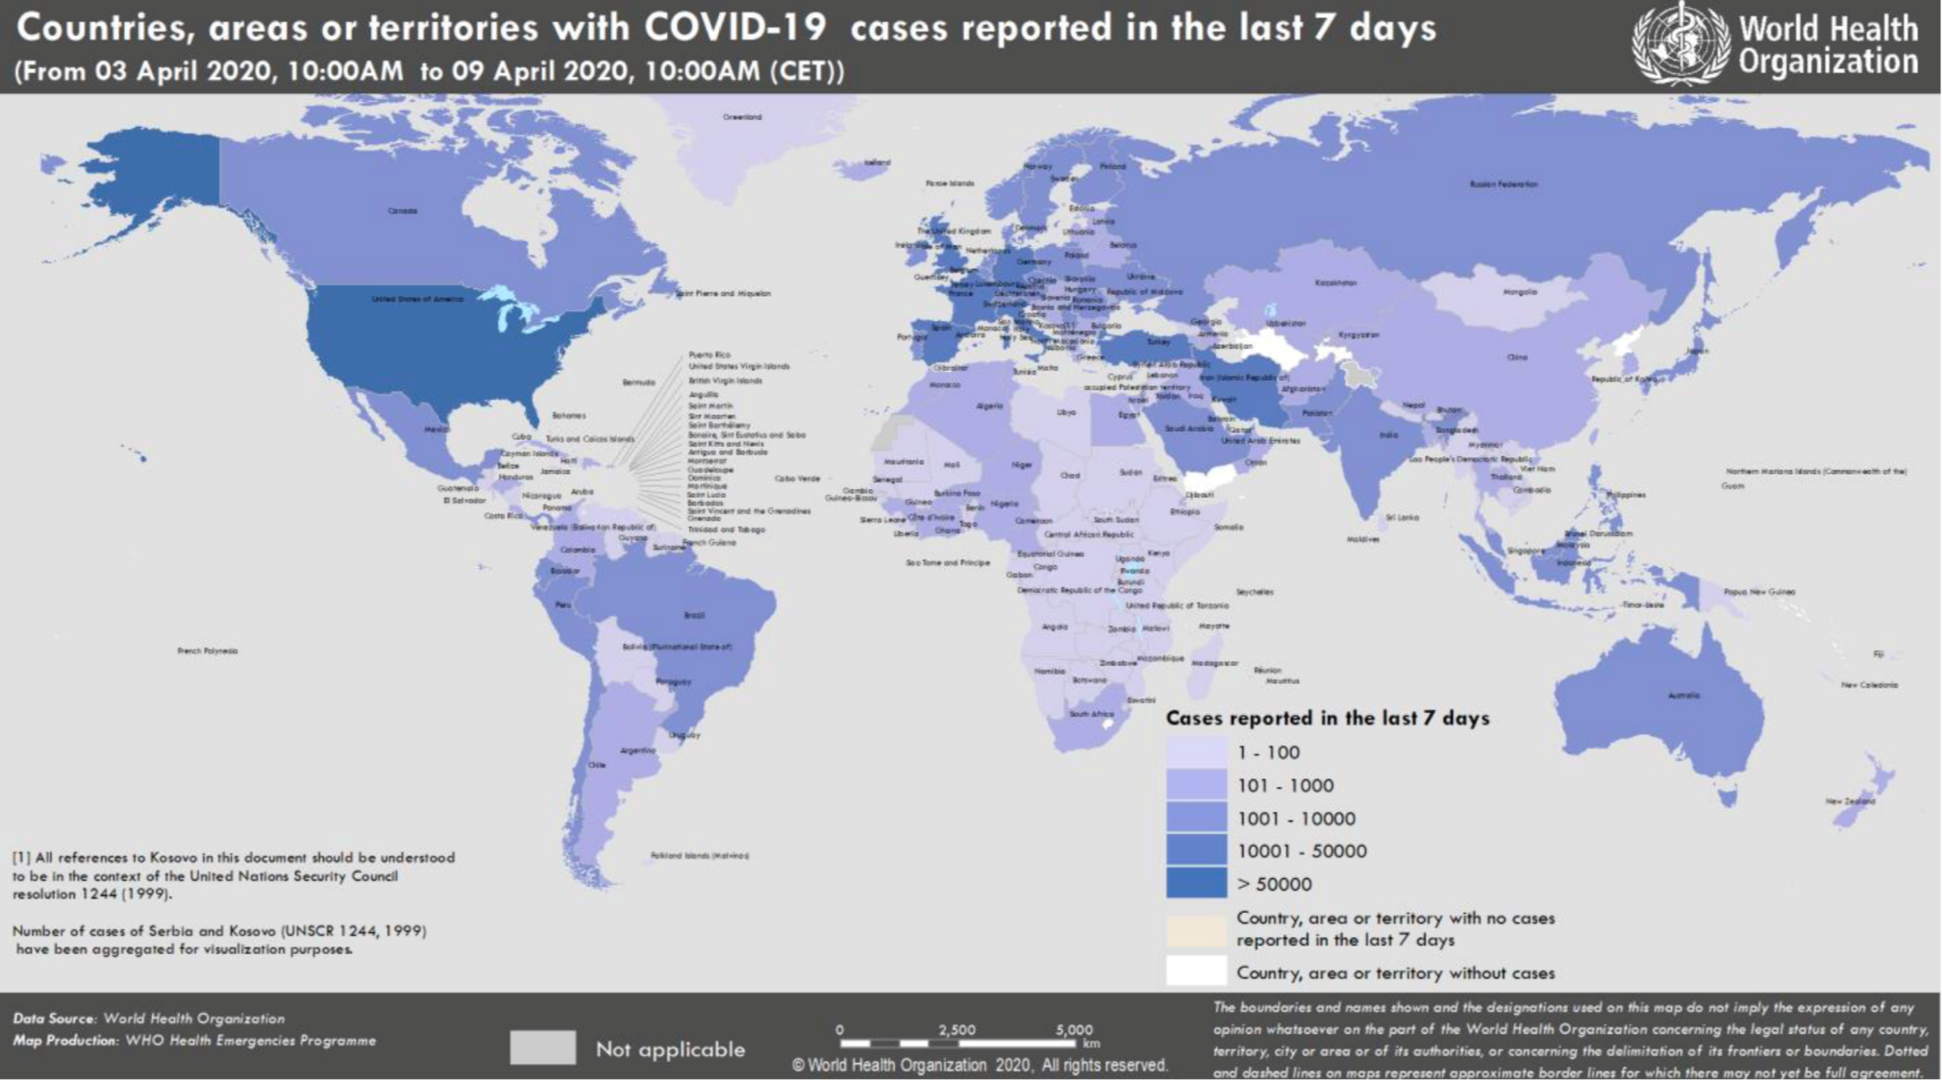
Global Situation
As of 09 April 2020
Source: WHO

Slide 3
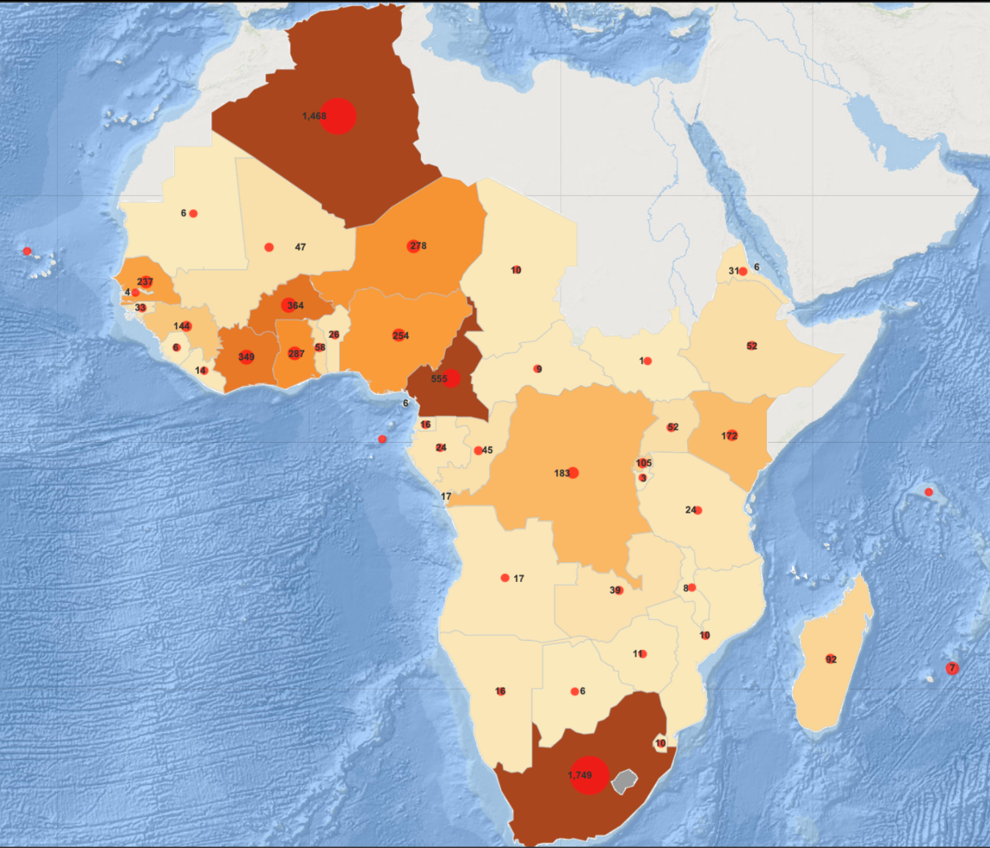
COVID-19 in the African Region
As of 09 April 2020
African Region:
8 337 Confirmed cases with 349 deaths
SADC Region:
The 14 SADC countries continue to register an increased number of cases
To date, the SADC Region has reported 2 740 confirmed cases
 | Total Confirmed Cases | Total New Cases
South Africa | 2 003 | 71
Mauritius | 273 | 7
DRC | 207 | 20
Madagascar | 93 | 0
Zambia | 39 | 1
Tanzania | 25 | 1
Angola | 19 | 2
Mozambique | 17 | 0
Namibia | 16 | 0
eSwathini | 12 | 0
Seychelles | 11 | 0
Zimbabwe | 11 | 3
Malawi | 8 | 1
Botswana | 6 | 1
TOTAL | 2 740 | 107

Slide 4
PROVINCE | CONFIRMED COVID-19 CASES | TOTAL DEATHS | TOTAL RECOVERIES
GAUTENG | 801 | 3 | 157
WESTERN CAPE | 541 | 6 | 152
KWAZULU – NATAL | 412 | 12 | 15
FREE STATE | 94 | 3 | 61
EASTERN CAPE | 68 | 0 | 3
LIMPOPO | 24 | 0 | 13
MPUMALANGA | 20 | 0 | 6
NORTH WEST | 18 | 0 | 3
NORTHERN CAPE | 15 | 0 | 0
UNALLOCATED | 10 | 0 | 0

Slide 5
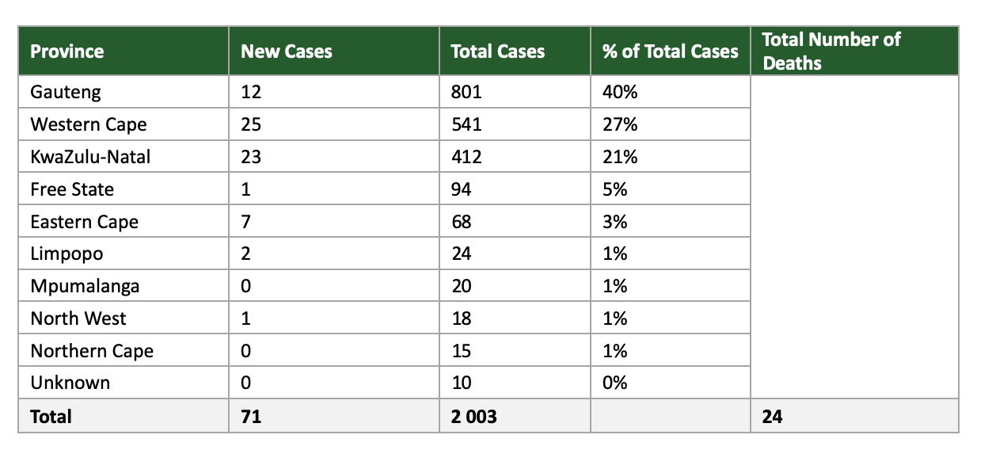
Geographical Distribution for South Africa
As of 09 April 2020
*Information on deaths not yet broken down by province

Slide 6
CONTACT TRACING
Province | Contact Traced | No of screened people | No of tracers
Western Cape | 1811 | 8215 | 137
Gauteng | 4133 | 47471 | 8005
KZN | 1366 | 2116 | 1240
Mpumalanga | 600 | 447 | 642
Limpopo | 220 | 66550 | 405
Eastern Cape | 374 | 66964 | 1053
Free State | 1789 | 33682 | 29
Northern Cape | 115 | 91639 | 996
North West | 244 | 138990 | 981
TOTAL | 10652 | 456074 | 13488

Slide 7
Situational Analysis for South Africa
As of 09 April 2020
Total # of Cumulative Cases by Day
Total # of Cases by Age Disaggregation
Total # of New Cases
New Cases

Slide 8
Hospitalized Patients
Revised as 9th of April

Slide 9
Community Screening and Testing Programme
Revised as 8th of April
Assumptions to Note:
Provincial Reporting --- Numbers updated as of April 8th

Slide 10
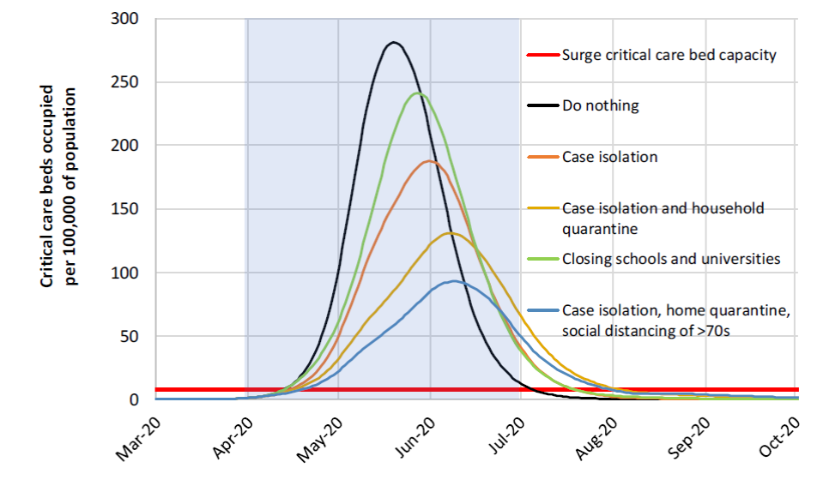
Imperial College Modelling of effectiveness of interventions

Slide 11
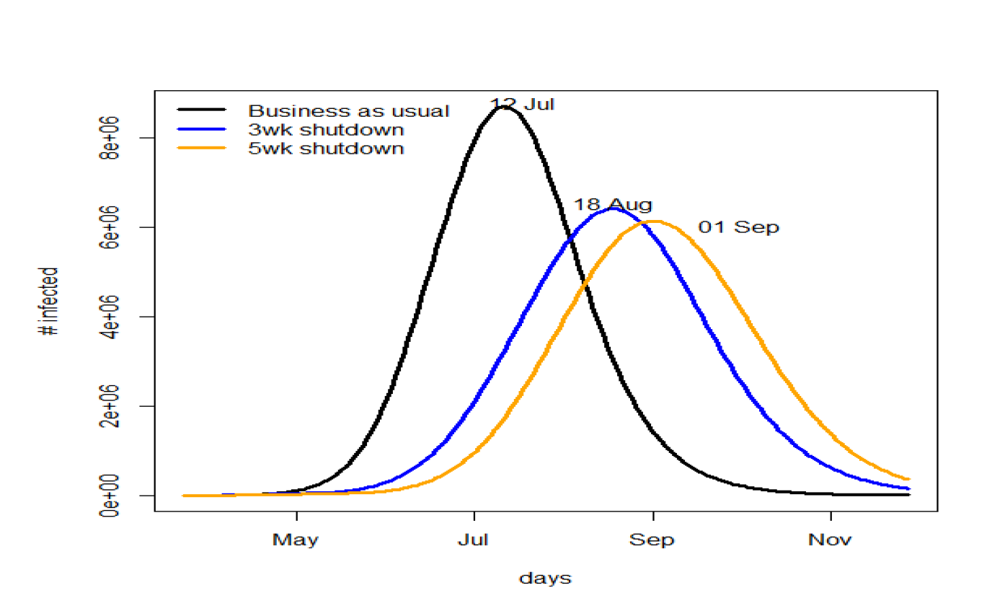
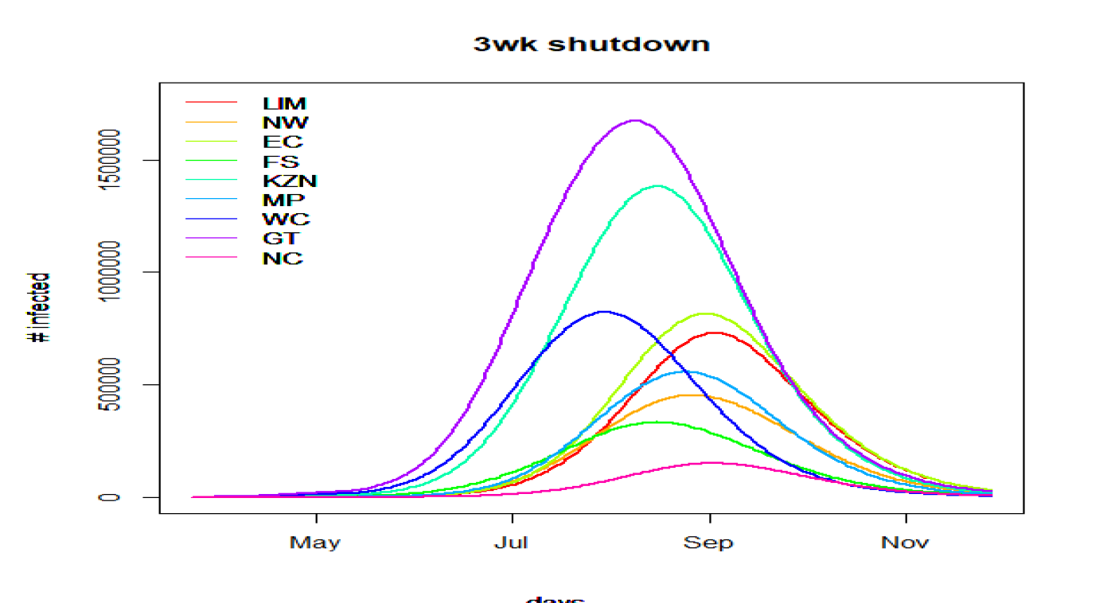
Readiness for Worst Case Scenario
Source: MASHA currently under review (as of April 8^{th)}

Slide 12
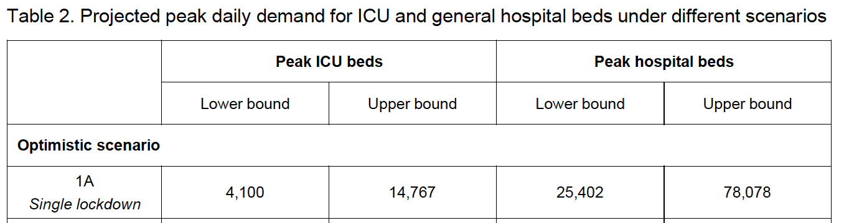
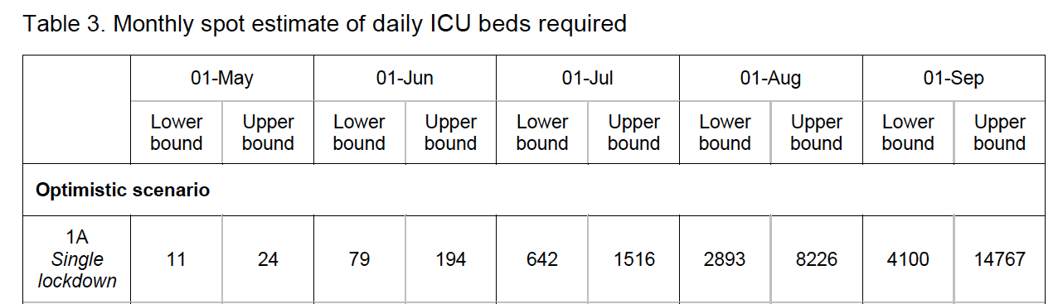
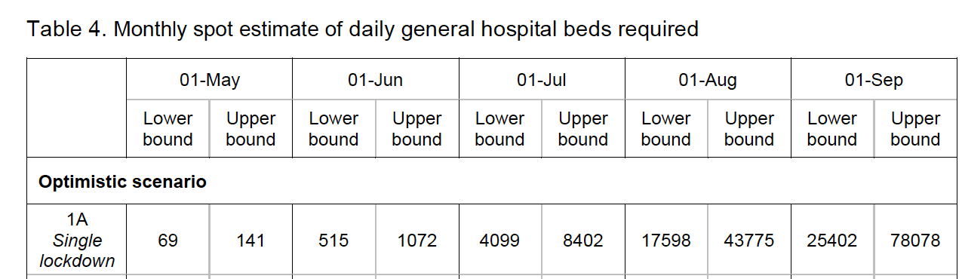
Estimated Bed Requirements
Source: MASHA currently under review (as of April 8^{th)}

Slide 13
Facility Readiness --- Beds and Ventilators
Assumptions to Note:
90% of CC beds in the country have physical working ventilators in place
20% of Paeds/ neonatal CC beds have a working ventilator that can be used for adults (the remainder can be used for Paeds and will suffice taking into account this disease does not affect a large amount of this patient population)
Existing bed capacity is calculated using all CC beds registered, half the high care beds registered and 20% of paediatric/ neonatal beds registered. This in terms of both physical space and infrastrucutre required for those beds (suction, gas supply, electricity)
Source: DHIS, Facility Readiness Team

Slide 14
Quarantine and Testing Stations per Province
Quarantine | National | Eastern Cape | Free State | Gauteng | KwaZulu-Natal | Limpopo | Mpumalanga | North West | Northern Cape | Western Cape
Total planned quarantine sites | 1 644 | 86 | TBC | 968 | 313 | 80 | 173 | TBC | 9 | 15
Total number of activated sites | 21 | 0 | 0 | 3 | 8 | 2 | 2 | 0 | 4 | 2
Total Number of beds available (total planned) | 7 356 | 328 | 1 117 | 1 172 | 613 | 772 | 1 481 | 248 | 43 | 1 582
Total number of people placed in quarantine | 609 | TBC | TBC | 359 | 22 | 29 | 128 | 12 | 23 | 36
Total number of quarantined tested positive | 14 | 0 | 0 | 0 | 0 | 0 | 0 | 0 | 0 | 14
Source: WHO

Slide 15
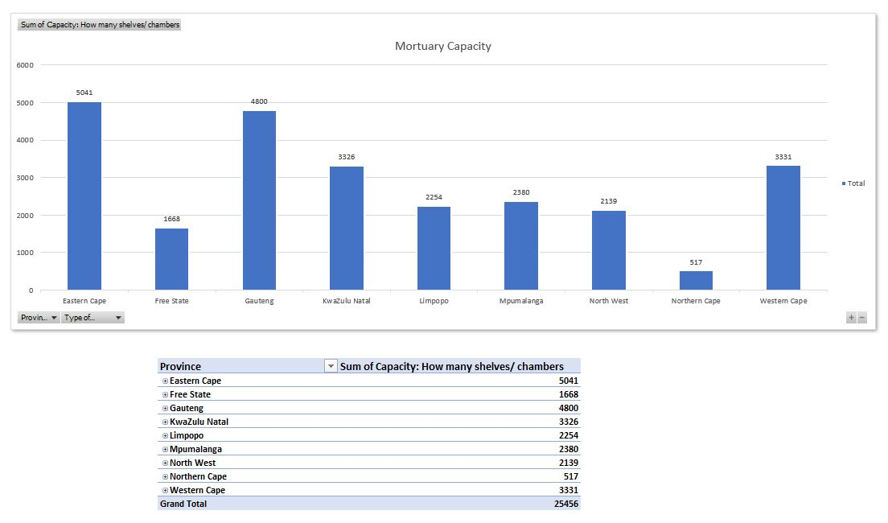
Mortuary Capacity

Slide 16
Field hospitals will incorporate five essential functions
Isolation of COVID-19 patients from the community;
Triage of patients into the three prioritized categories listed below to enable severe to critical COVID-19 patients to be separated and sent immediately to the hospitals with intensive care units (ICU) and to isolate the mild to moderately infected patients into the field hospital;
Provision of basic medical care including antiviral, antipyretic and antibiotic medication; oxygen supplementation and intravenous fluids; and mental health counselling;
Frequent monitoring and rapid referral;
Essential living and social engagement which includes shelter, accommodation, food, sanitation, and hygiene as well as spaces to eat together and socialize.

Slide 17
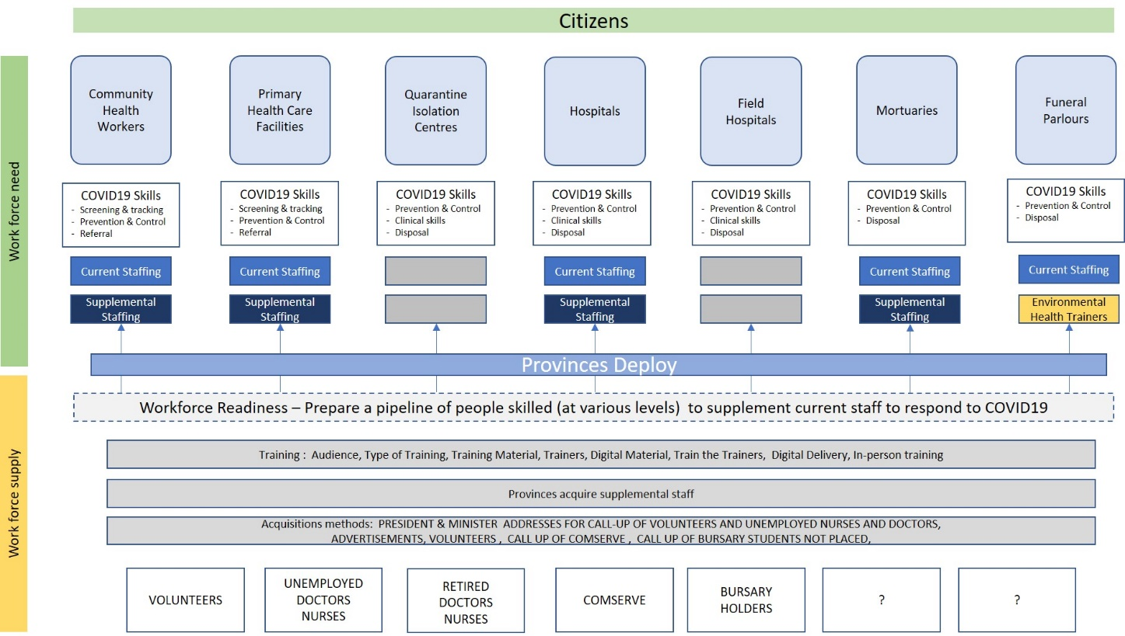
Facility Readiness --- HR

Slide 18
Provincial Health Capacity
Source: WHO

Slide 19
Mobile Testing Units
Source: WHO

Slide 20
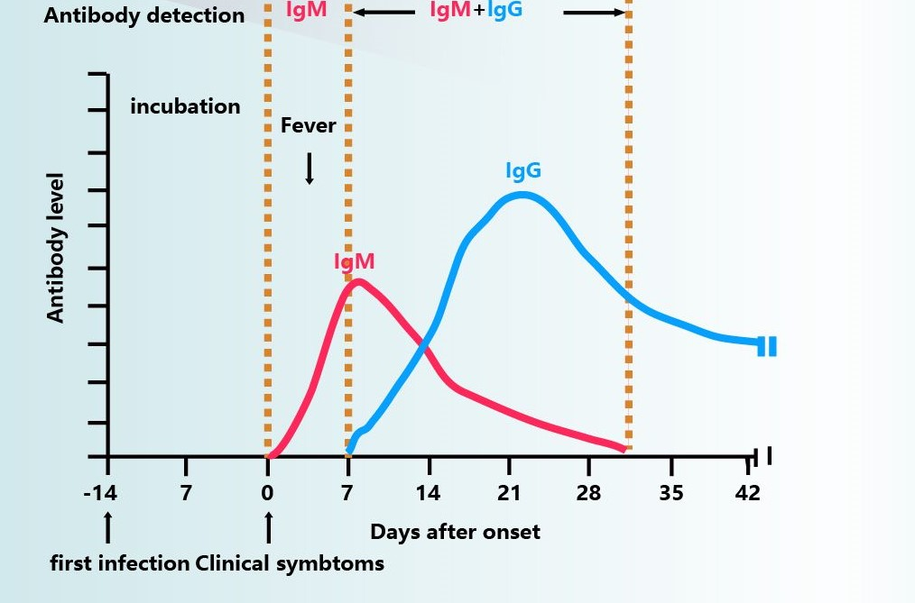
Rapid test Kits
A wide range of these serological test kits are available that measure IgM/IgG using lateral flow on a test strip.
These tests do not have the same accuracy as the PCR based test. However the rapid test kits can produce a result within 10 to 20 minutes which allows the individual to be immediately isolated.
The PCR based test requires a swab to be done and the sample must be sent to the lab for the analsysis to be done – longer time lag and costs more.
Given that not all rapid tests have been validated we must procure tests that would produce an accurate result. A number of countries have evaluated these products and validated those that are accurate.
SAHPRA is working with those companies validated by other countries to fast track the registration of these products.

Slide 21
Personal Protective Equipment
Source: Revised as of April 8th 2020

Slide 22
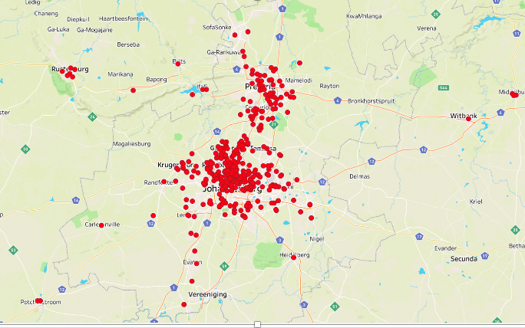
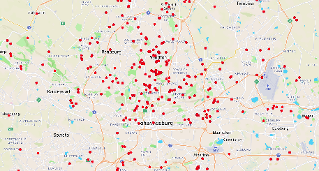
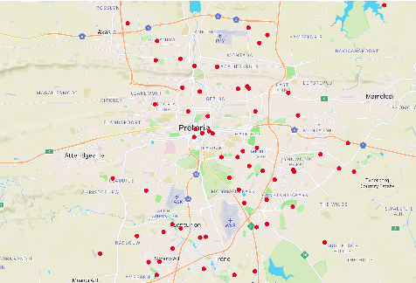
Geo-Mapped Breakdown of Infections per Region
Mapping of 1082 COVID cases – Gauteng
Source: WHO

Slide 23
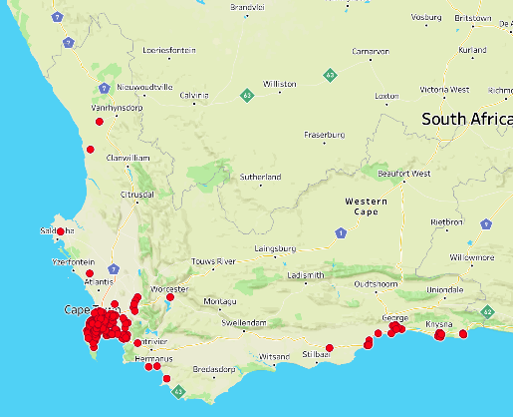
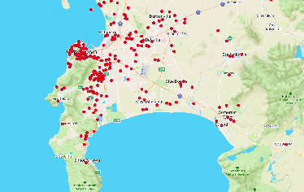
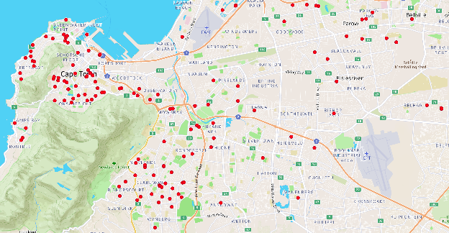
Geo-Mapped Breakdown of Infections per Region
Mapping of 1082 COVID cases – Western Cape
Source: WHO

Slide 24
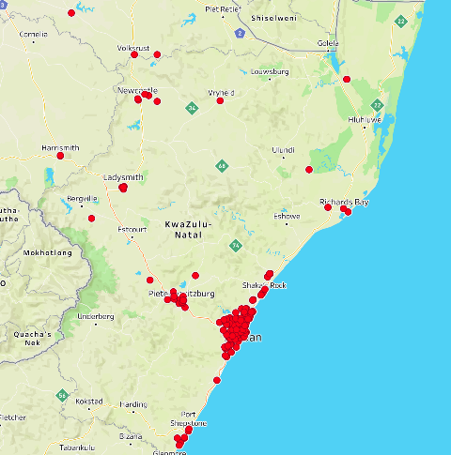
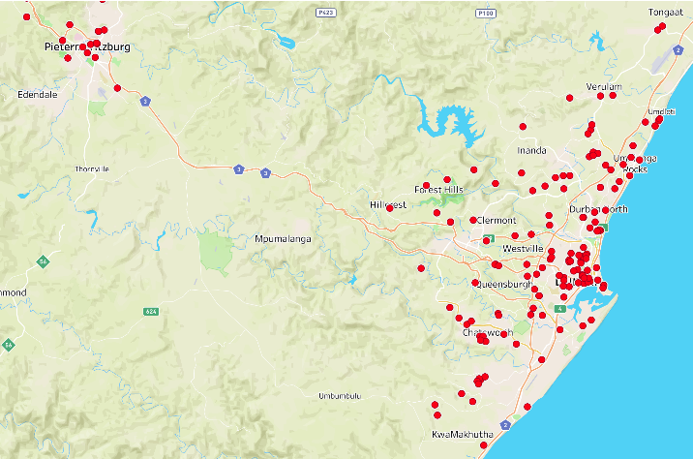
Geo-Mapped Breakdown of Infections per Region
Mapping of 1082 COVID cases – Kwa-Zulu Natal
Source: WHO

Slide 25
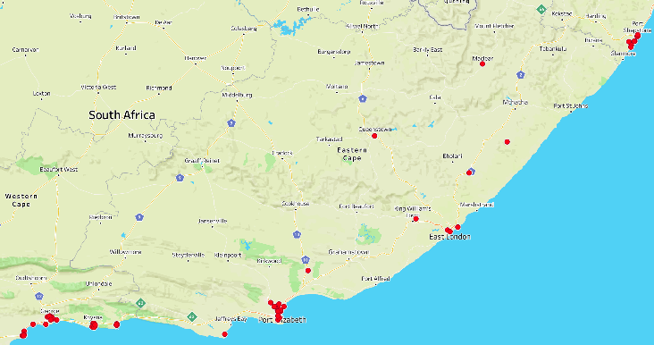
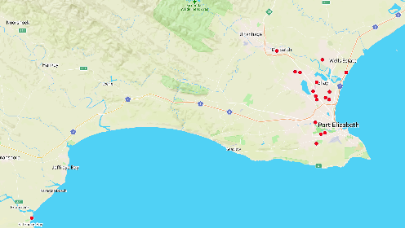
Geo-Mapped Breakdown of Infections per Region
Mapping of 1082 COVID cases – Eastern Cape
Source: WHO

Slide 26
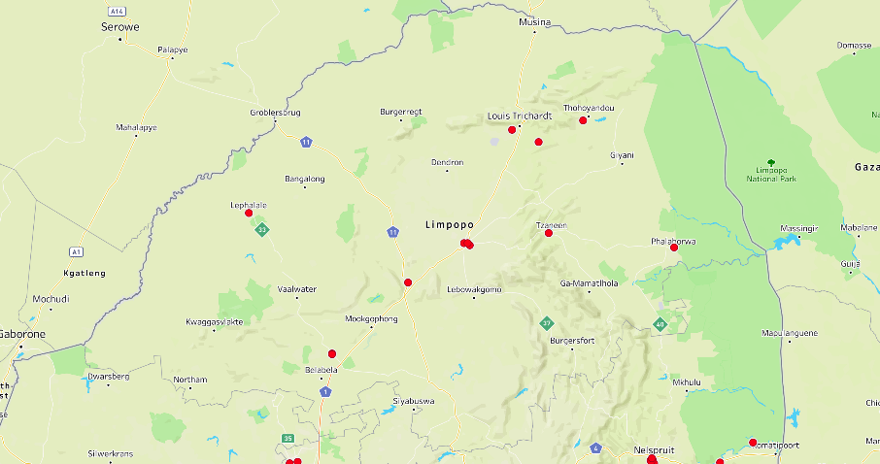
Geo-Mapped Breakdown of Infections per Region
Mapping of 1082 COVID cases – Limpopo
Source: WHO

Slide 27
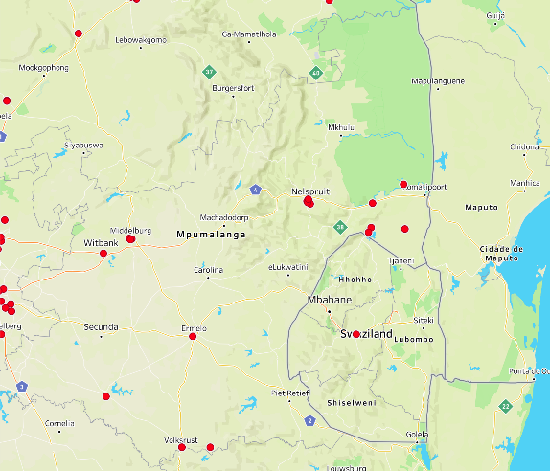
Geo-Mapped Breakdown of Infections per Region
Mapping of 1082 COVID cases – Mpumalanga
Source: WHO

Slide 28
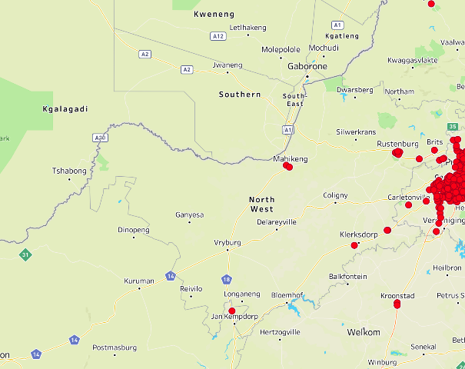
Geo-Mapped Breakdown of Infections per Region
Mapping of 1082 COVID cases – North West
Source: WHO

Slide 29
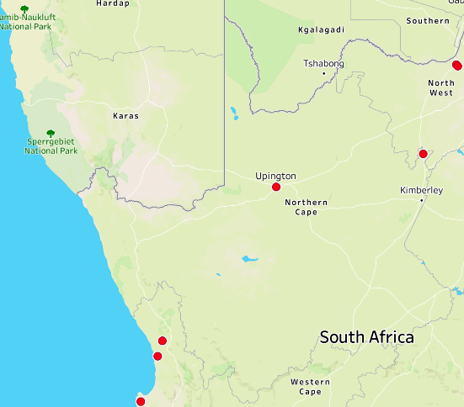
Geo-Mapped Breakdown of Infections per Region
Mapping of 1082 COVID cases – Northern Cape
Source: WHO

Slide 30
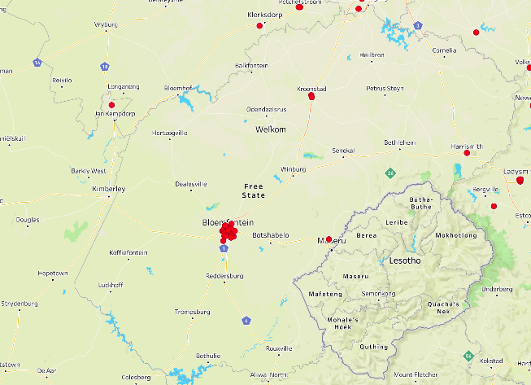
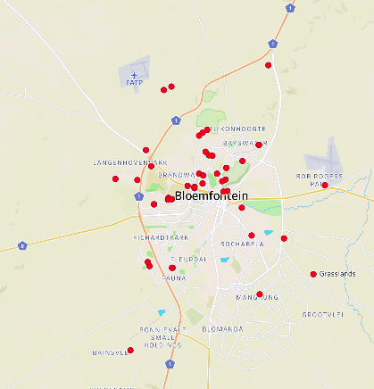
Geo-Mapped Breakdown of Infections per Region
Mapping of 1082 COVID cases – Free State
Source: WHO

Slide 31
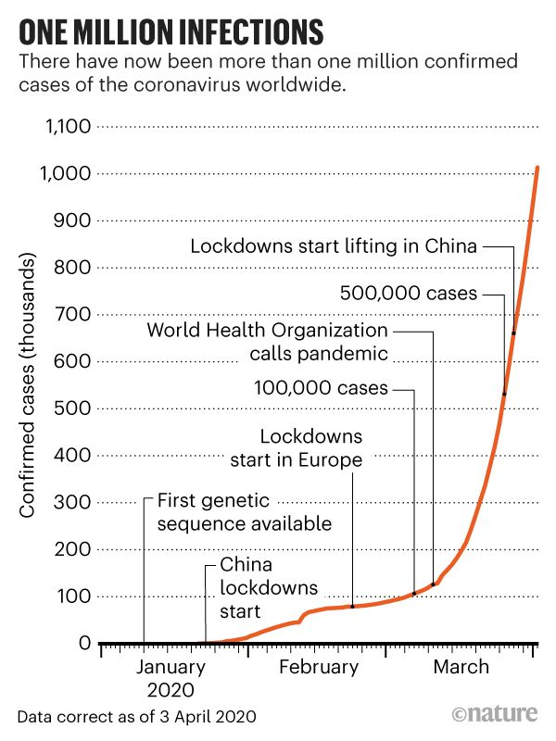
Source: Nature 2020

Slide 32
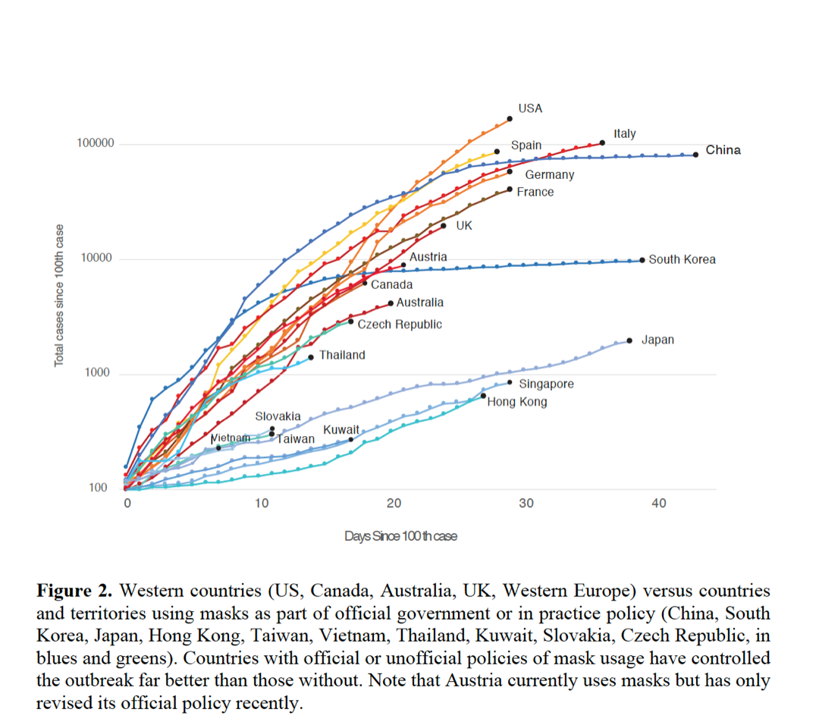
What should we have expected based on global Covid experience?
Source: Shaheen Metha

Slide 33
But we are seeing a different trajectory…
Source: Tulio D’Oliviera

Slide 34
MASKS
Note 1: Face-masks are recommended as an addition to hand-washing and social distancing – it does not replace these 2 more important prevention strategies The cloth face-mask should never be promoted as our primary prevention strategy and should never be promoted separately from hand-washing and social distancing.
Note 2: The public should not use N-95 respirator masks and surgical masks Surgical masks and N-95 masks are critical supplies that must be reserved for healthcare workers and other medical first responders. The public should be strongly discouraged from using these medical-use masks.
Note 3: Cloth face-masks need to be worn and cleaned properly The face-mask must cover the nose and mouth completely. Face-masks should not be lowered when speaking, coughing or sneezing. Face-masks should not be repeatedly touched – fidgeting with the mask repeatedly is strongly discouraged as it is important to avoid touching the face with hands. The inner side of the mask should not be touched by hands. Wash hands after removing the face-mask. Wash cloth face-masks with warm soapy water and iron when dry. Each person will need to have at least 2 face-masks so that one face-mask is available when the other is being washed. If possible, iron the mask after washing as it will help with disinfection

Slide 35
MASKS CONTINUED:
Recommendations:
• Everyone in South Africa should wear cloth face-masks when in public
.
• Members of the public should not use N-95 and surgical masks. These medical masks remain reserved only for healthcare workers.
• The main benefit of everyone wearing a face-mask is to reduce the amount of Coronavirus or Influenza virus being coughed up by those with the infection thereby reducing its spread through droplets. Since some persons with the Coronavirus may not have symptoms or may not know they have it, everyone should wear a face-mask.
• Handwashing and social distancing remain the most important prevention strategies for Coronavirus infection since there is little evidence at this time that face-masks protect people against getting infected with the Coronavirus

