Slide 1
Phase One Inoculation Webinar
Prof Koleka Mlisana
AARQA Executive: NHLS
Department of Health Public Webinar
27 January 2021

Slide 2
Vaccine Myths and Misinformation
A myth = a widely held but false belief or idea
Intsomi in Xhosa
Inganekwane in Zulu
Misinformation = ‘false or inaccurate information
Disinformation = ‘false or misleading information that is spread deliberately to deceive

Slide 3
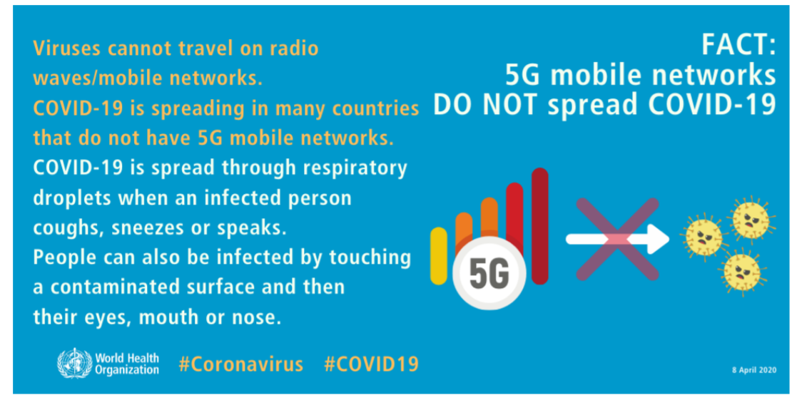
5G and Viruses

Slide 4
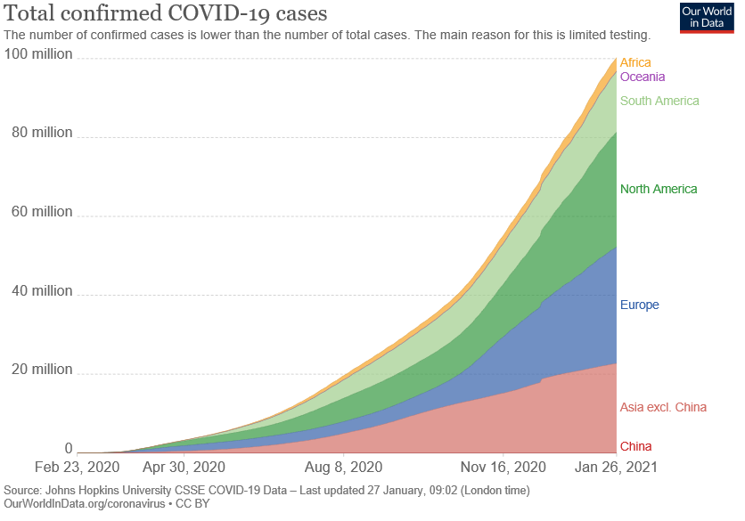
30.58 mil cases of COVID-19 in USA vs 3.48 mil in Africa (1.42 mil in SA)
425 216 deaths in USA compared to 85 955 in Africa (41 797 in SA)
Far more deaths in the West than in Africa

Slide 5
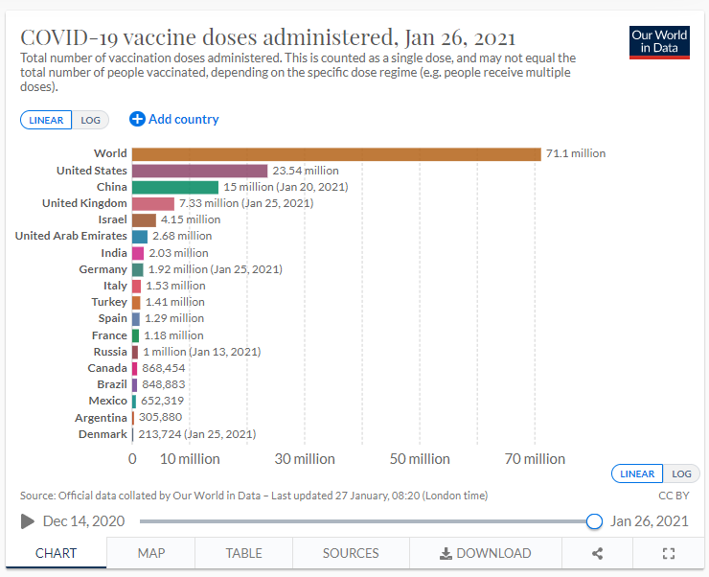
6.56 million (Jan 26, 2021) people worldwide have been fully vaccinated

Slide 6
Vaccination saves lives
Vaccine vial contains more than 1 dose
There is no microchip or tracking device of any kind in any of the vaccines
All Vaccine ingredients are declared to the regulating body!!!
Vaccines will NOT alter the DNA –
mRNA vaccines are a set of instructions that inform cells in the body to make proteins that will stimulate an immune response for the prevent or fight disease.

Slide 7
We are a nation that vaccinates its children…..every mother knows that!!! Estimated national childhood immunization coverage > 80% (2019)

Slide 8
Thank you !!!!
Remember, Vaccines do not save lives, vaccinations do!!!!
Train yourself to check whatever information you come across!!!!… don’t accept things at face value!! FACT CHECK!!!
www.reuters.com

